Slide 1


Micro Frontends:
Conceito e Aplicação no Portal de Tributos
+

Slide 2
Padrões de arquitetura web – Monolítica ou Microserviços?
Notes:
Before we talk about microfrontends, let’s take a look at some of the other ways we build web applications.

Slide 3
Monolith
Application
UI
Altamente acoplado
Escalabilidade limitada
Falta de flexibilidade
Dificuldade para manter
Dificuldade para colocar alterações em produção
Perda de agilidade
Business Logic
Data Access
DB
Notes:
So, this is a familiar approach.
We have an N-tier architecture, but all of our code is together in the same project. It builds together, deploys together, and runs together.
This appraoch has its benefits. It’s easy to set up and easy to work with, but as your project and organization grow, you start to run into some issues.
Tightly coupled - low reusability
Not Scalable - can’t scale independently
Reduced Agility - Scary Deployments
Difficult to maintain - Difficult to grok
Tech Lock-in

Slide 4
Microserviços
UI
Baixo nível de acoplamento e interdependência
Facilidade para manter
Escalabilidade
Flexibilidade
Autonomia entre equipes
Redução no lead time
Orders
Cart
Items
Profile
DB
DB
DB
DB
Notes:
Microservices have been around for awhile and provide solutoins to these problems.
Instead of having one giant system that does everything, you split it up into smaller services that each do one thing.
Easier to maintain -

Slide 5
UI
Notes:
UI is growing - more complexity is shifting from back to front end.
Describe problems with monolithic front end.

Slide 6

Micro Frontends

Slide 7
“Um estilo de arquitetura onde fragmentos de frontends são agrupados em uma aplicação maior”

Slide 8
Micro Frontends
Container App
Orders UI
Item Listing UI
Edit Profile UI
Shopping Cart UI
Orders
Cart
Items
Profile
Notes:
Our front end monolith from before is split into these “microservices” in the browser.

Slide 9
http://myapp.com
Welcome to My App! Log Out
http://overview.myapp.com
Notes:
So what does this look like?

Slide 10

http://myapp.com/orders
Your Orders
http://orders.myapp.com
http://sidebar.myapp.com

Slide 11
Micro Frontend
Micro frontends são entregues de forma independente
Desenvolvimento independente
Teste independente
Deploy independente
Notes:
The key here is that micro frontends be independently deliverable.

Slide 12
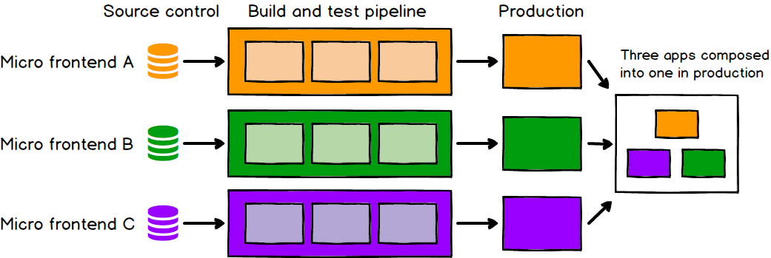

Slide 13
Como implementar?
Notes:
Before we talk about microfrontends, let’s take a look at some of the other ways we build web applications.

Slide 14
Soluções Micro Frontend
Navegar entre aplicações separadas com sessão de autenticação compartilhada
IFrames
Web Components
Integração em tempo de execução com JavaScript

Slide 15
single-spa
Um framework Javascript que garante o desenvolvimento de micro frontends com liberdade de escolha de qualquer outro frontend framework, realizando a integração entre cada parte desenvolvida.
https://single-spa.js.org/

Slide 16


Slide 17
Single-spa
O framework single spa consiste em:
Aplicações micro frontends que implementam o framework e seus ciclos de vida
Aplicação root, responsável por chamar cada micro frontend de acordo com a rota cadastrada

Slide 18
Desvantagens
Infraestrutura complexa, assim como microserviços
Duplicidade de dependências
Desenvolvimento local fica mais complexo

Slide 19
Links úteis
https://single-spa.js.org/docs.html
https://martinfowler.com/articles/micro-frontends.html
https://medium.com/@cleisonferreiramelo/the-journey-to-building-a-full-microservice-app-changing-the-angular-frontend-to-micro-frontend-4eca0d5f2ae2

